Slide 1
Data, Measures and Insights
OSSPI Spring Training Series
April 6, 2018

Slide 2
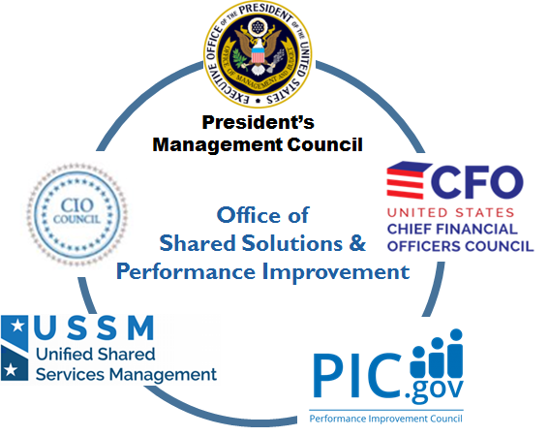


Introduction to OSSPI
In February 2018, the Office of Executive Councils (OEC) and the Unified Shared Services Management Team (USSM) came together and became the Office of Shared Solutions and Performance Improvement (OSSPI).

Slide 3




Bringing our Capabilities to Bear
Fed2Fed Solutions combines our capabilities, knowledge, and networks to support agency strategy development and execution on key management initiatives.
Objectives of Fed2Fed Solutions, 2018 and Beyond
Provide performance management support and data to agency COOs to strengthen administrative support delivery decisions and execution of priorities, leveraging the government-wide strategy (e.g., PMA) where applicable.
Support agencies with best practices/tools/advice on mission support services transitions/modernizations to help the government achieve successful outcomes.
Use data science/analytics and SMEs, leveraging government-wide data sets, to help inform/drive agency and government-wide management decisions/initiatives.
Promote access to a cross-Agency network of CXOs and SMEs for peer-to-peer discussions and strategic thinking and problem solving on government-wide challenges.
Contact us at Fed2FedSolutions@GSA.gov

Slide 4
Today’s training
Agenda
Welcome and Overview Dana Roberts
Performance Measurement Basics Boris Arratia and Steve Richardson
Dashboarding Todd Coleman
Data Driven Reviews Dana Roberts

Slide 5
Performance Measurement Basics
Boris Arratia, OSSPI
Steve Richardson, Department of Labor

Slide 6
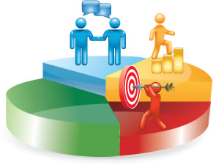
Performance Management is …
The systematic process of collecting, analyzing, and using performance measurement and evaluations to track progress, influence decision making, and improve results
6
Notes:
Slide Takeaway
Performance management – monitoring, evaluating, analyzing, and communicating—is just as important for projects and processes as for programs. In particular, processes are often behind the scenes and not elevated to the prominence that they deserve. Emphasize the “analyzing and using” components of the definition!
Facilitator Notes
The key point here is that managing performance requires reliable information and data about that performance. Analysis of this information should then support decision-making and adaptive management; i.e., to adapt—and to improve. This implies that there is no perfect logic model, program summary—and that over time there may be the need to adjust the logic model and ToC. Over the life of the P/P/P, more learning and understanding of the problem being solved, or the efficacy of solutions being implemented, may lead to adjustments – this is the point of the feedback loops we discussed earlier.

Slide 7
APG & CAP Goal Performance Management
OMB Circular A-11 tells us to:
Review Internally
Review progress at least on a quarterly basis.
Determine how to improve performance and resolve problems.
Discern if the goal has been achieved by end of 24-month period (APGs).
Report Publicly
Track progress on each goal through performance indicators and milestones.
Provide quarterly updates to Performance.gov, including achievements, significant challenges, risks, targets, and actual results.
APG: Agency Priority Goal, CAP: Cross-Agency Priority Goal
7
Notes:
Notes:
Set the Bar: To begin, we have to understand what data we’re supposed to collect and report for APGs, and what we’re supposed to be able to do with that information.
These are some statements taken from A-11.
Key Words that jump out: Quarterly Update; P.gov=Public; Indicators; Milestones; Targets; Results; Risks; Challenges; Progress
Ask participants: what do you think is the intent of the APGs? What makes them different from the rest of your performance goals?
So at minimum, we need to be sure that:
we establish APG indicators that enable us to internally review and assess our progress towards the goal,
they are achievable within a 24-month period,
they have data/milestones which enable us to publically report our progress and results on a quarterly basis.
But do we always achieve APGs by end of 24-month period? Don’t think this is always the case, as there are instances for re-upping APGs and establishing additional future targets.
--------------------------------------
ADDITIONAL INFORMATION
The Slide Shows the Basic Requirements. A-11 also tells us that:
“Generally, goals should take into account the available evidence, including any available evaluation results, and whether the goals and indicators have been validated through research. This should be well correlated with ultimate outcomes, implications of available research on the appropriateness of the measure, and whether the available research indicates that the use of the measure may encourage negative unintended consequences.”
Alternative form or qualitative goal statements may be appropriate in certain cases. Such alternative form goal statements may be supported by milestones that make it possible to assess if progress is being made or, in other circumstances, progress across a suite of indicators. Agencies are encouraged to include baseline data in the goal statement (e.g., reduce by 10 percent from a previous year’s level of baseline), although goals for which data collection will be initiated but for which the data are not yet available are acceptable, provided dates for initiating or continuing data collection are set as milestones
Each agency will include a brief explanation of achievements during the last quarter on Performance.gov (or, for the last quarter of the year, a summary of accomplishments over the last fiscal year), as well as an identification of significant challenges if any impeded progress on the APG. Because of their ambitious nature, all APGs face some risks with regard to the stretch targets set; therefore, agencies should include a description of significant risks of not achieving the planned level of performance, as appropriate.

Slide 8
What is an Indicator?
OMB’s definitions in A-11
Indicator: A measurable value that indicates the state or level of something
Performance Indicator: The indicator for a performance goal or within an Agency Priority Goal statement that will be used to track progress toward a goal or target within a timeframe. By definition, the indicators for which agencies set targets with timeframes are performance indicators.
** Note: We’ll use the terms Measure and Indicator interchangeably throughout this presentation
Notes:
Slide Takeaways
Definition of an indicator, and indicators’ key uses to (1) monitor progress and (2) measure actual versus expected results. An indicator is a particular characteristic or dimension used to measure intended changes. Performance indicators are used to observe progress and to measure actual results compared to expected results.
Indicators provide evidence of progress and results that help your agency:
-- communicate to stakeholders –such as Congress and the American people –what is being achieved from the resources being spent
-- provide evidence of what works and doesn’t work
-- make strategic choices based on data
-- support increased accountability and transparency
Because collecting data on indicators requires resources and, as such, the indicator selection, collection, and analysis efforts should be focused on utility. Uses may vary: for internal learning, accountability, and external reporting, for example. Again, if they are tied back to your logic model, there’s a good chance they will have utility for you in some capacity.
Good practice suggests that indicators should be "neutral" – that is, not expressed as the desired state. For example, instead of "Improved score on customer satisfaction rating“ the indicator should be "Score on customer satisfaction rating,“ with the indicator target used to communicate the desired state vis a vis the result being measured.
Facilitator Notes
Remind the participants that indicators do not tell the full story; they can only indicate that you are making progress towards achieving or not achieving your expected results.
Note the “MEASURE” and “OBSERVE PROGRESS” in this definition. The two main uses for indicators are: (1) to monitor progress and, (2) measure actual results compared to expected results.
Developing indicators is both a science and an art. Measuring, monitoring, analyzing and reporting performance is likewise complex. But we are learning, developing best practices, and improving performance management all the time.
There are certain qualities an indicator should have, such as being neutral and having utility, but sometimes we have to get creative to find indications of our progress and results when the thing we want to measure is not directly measurable. Or, we may know of a directly measurable indicator, but we simply don’t have access to the data (e.g. cannot get a hold of certain government records) or cannot afford to collect it (e.g. we can’t afford to track people to document their behavioral or attitudinal changes at different points in time). In these cases, we have to get creative.
The key point is that without indicators, it is very difficult to make decisions, to adapt and learn, and to defend and promote the successes and progress that your agency is making worldwide.
Learning Opportunities
We often hear “M&E” lumped together as a concept. ASK: But how are they the same or different?
Both measure progress and results
Monitoring tells what is happening, such as if implementation is on track or things need to be adjusted
Evaluation tells what is happening but also looks at how or why results occurred. It can also look at efficiency, effectiveness, sustainability, and relevance.

Slide 9
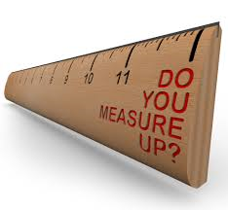
Characteristics of Indicator Quality - I
Characteristics of Good Performance Indicators
Indicators should be:
Objective
Practical
Useful
Direct
Attributable
Timely
Adequate
OPUDATA
There will always be tradeoffs. . .
Notes:
Facilitator Notes
When assessing the quality of indicator ideas, consider OPUDATA. Discuss each characteristic and it’s value. In discussing these qualities, ask participants if:
they have experienced any tradeoffs among the OPUDATA qualities, and why or how (e.g. we wanted x, but it wasn’t practical so we went with y, which was less timely but all we could get)
they have ever tried to collect indicators and realized they were missing a key component of OPUDATA and what effect that had, what they would do differently.
There may be tradeoffs among these characteristics, and discuss these possibilities. For example, it may be super Useful to document the age or sexual orientation of all the beneficiaries of a particular program or project, but it’s simply not Practical to try and obtain this across 1,000 beneficiaries because it’s culturally insensitive or too time consuming/costly for implementers to do so.
Performance data should be as complete, accurate, and consistent as the management needs and resources permit
Objective. Performance indicators should only measure one thing and be unambiguous about what is being measured. All subjective terms that could be interpreted differently by various stakeholders should be clearly defined in the indicator reference sheet so the program team as well as any partners use and interpret the indicator correctly and consistently.
Practical. What data are you already collecting or have easy access to? Consider the feasibility of collecting the data. Certain indicator data that, on their face, could be extremely useful to gauge progress or results may be impossible to obtain due to budget, geography, time, availability, quality, or other constraints.
Useful. Data collection can require considerable time and resources. Consider what questions and decisions could arise during program implementation and beyond, and validate the data captured in your indicators. Have a clear utility for learning, tracking, informing decisions, or addressing ongoing program needs.
Direct. When feasible, indicators should directly measure the desired program result (e.g., measuring GHG levels to indicate changes in GHG levels). When this is not possible, program teams can use proxy indicators, which measure variables that can approximate or represent something that is too difficult or infeasible to measure directly (e.g., measuring a variable such as smog or air quality scores that is known to be consistently affected by changes in GHG levels to serve as a proxy for changes occurring in GHG levels).
Attributable. The program team should include indicators in its overall monitoring plan that measure factors that are the direct result of program activities. Output and short-term outcome indicators often measure results that are directly attributable to program activities. This is important data for the program team to use to establish whether or not these aspects of the program logic model are on track and producing expected results. Note that although long-term outcome indicators typically measure effects that the program only contributed to, they are also important to include in the overall monitoring plan in order to assess the full breadth of the program logic model.
Timely. Keep in mind, APGs are reported quarterly! Performance indicator data must be available in time for it to be used in decision making or the other purposes for which it is intended. Perfect data that come in after decisions had to be made or after a report deadline are not useful.
Adequate. Because data collection can be costly, the program team should have only as many indicators in their overall monitoring plan as are necessary and feasible to track key progress and results, inform decisions, conduct internal learning, and meet any external communication or reporting requirements.
In discussing these qualities, it may be useful to ask participants if they have experienced any tradeoffs among the OPUDATA qualities, and why or how (e.g. we wanted x, but it wasn’t practical so we went with y, which was less timely but all we could get). Or if they have ever tried to collect indicators and realized they were missing a key component of OPUDATA and what effect that had, what they would do differently.

Slide 10
What are the strengths and weaknesses of these indicators?
What do you think of these indicators?
Level of greenhouse gas emissions and capacity for implementing clean energy regulations
Percent of energy produced from solar and wind sources
Number of disaster preparedness drills conducted
Building is able to withstand floods and earthquakes
Notes:
Indicators should only measure one thing and not include ambiguous words.
-The first indicator is weak because it tries to measure two things and the concept of “capacity” is subjective/ambiguous.
-The second indicator is clear and measurable, but the mission should be sure that adding both sources is a sufficient level of detail for their intended uses, or consider two separate indicators that capture solar and wind separately.
- The third indicator is strong: clear and measurable (assuming a standard definition of what a disaster preparedness drill consists of) but note that it is an output indicator
-The fourth indicator is more like a statement of a desired end state, or goal or objective statement rather than an ‘indicator’. The ‘ability to withstand floods and earthquakes’ is likely comprised of many underlying indicators/factors, some of which may be performing well and others which may be performing less well…it’s far more nuanced than a single indicator could capture. Conveying the overall ability of an embassy to withstand a flood and/or an earthquake is probably better achieved through analysis of several quantitative and qualitative data points…not a single indicator.

Slide 11

Developing Indicators: Sources to Consult
Potential Sources for Indicator
Logic Model/Project Charter
Indicators already captured by agency/office
Indices already captured by other organizations
Existing program or project metrics
Laws, regulations, other obligations
Strategic Plan(s)
Subject Matter Experts
Industry standards
Benchmark against similar service providers

Slide 12
Planning Tools
Goals describe where we’re heading.
Measures (or Indicators) provide trend data to indicate the direction and degree of progress.
Milestones establish markers of what should happen at selected intervals.
Strategies describe actions that we believe will influence measures and achieve our goals.

Slide 13
When to Use Measures
Time horizon is longer than a year or two
Measures involve significant commitments that will require time to implement and to yield useful data.
Therefore, measures should only be created or changed when you are confident that the data will be worth the cost and will be useful for several years.

Slide 14
When to Use Milestones
Measures are not available or data is irregular/there is a large lag
Milestones are very easy to establish or change. They can also have one or more interim milestones.
Milestones are ideal for short-term assignments, implementation plans, pilots, and exploratory projects, including review or creation of measures!

Slide 15
Don’t Develop Measures – Adopt!
New measures take time and don’t leverage existing data and practices, so first look at your agencies’ existing portfolio of performance measures.
Which are useful for GPRMA and other Dept. purposes (high level)?
Which are useful in measuring outcomes?
Which are leading or lagging indicators?
Leaders will want measures that show progress implementing their priorities.

Slide 16
Ready for Prime Time?
Select measures that meet other criteria:
Clear, concise, and properly formulated as a measure (See next slide)
Key component in logic model
Good data system

Slide 17
Anatomy of a Measure
If it does not include units, it isn’t a measure (and is inherently vague).
If it includes a target, it’s a goal, not a measure (and defies trend analysis).
Measuring an increase or reduction (i.e. delta) creates an arbitrary baseline, at best.

Slide 18
Data Quality Criteria
Reliable: Extent to which the data are collected and processed consistently, using the same procedures and definitions across collectors, reporting units, and over time. Systematic soundness of collection, processing, and calculation procedures, including estimation based on samples.
Complete: Extent to which required data elements are collected from all of the target population or a sample with defined estimation parameters. Data cover the performance period and all operating units or areas.

Slide 19
Data Quality Criteria (Continued)
Accurate: Extent to which the data are free from significant error and bias. Significant errors are those that would lead to inaccurate assessment of goal achievement. Note: Complete and Reliable contribute to and are necessary for accurate data.
Timely: Extent to which data about “recent” performance are available when needed to improve program management.

Slide 20
Measure Definition
When defining a measure, this is some of the key information we’ll want to provide:
the purpose of the measure,
qualifiers (scope),
who is responsible,
how it is calculated,
and relevance (the importance of the measure in the context of agency/program performance).

Slide 21
Measure Definition (Continued)
For example:
Rates other than percentages may need to be defined by providing a numerator, denominator, and/or other information (e.g., Entered Employment Rate)
Technical or vague terms and/or acronyms may require definition (e.g., “timely,” “matters,” “impact inspection,” SBREFA, etc.)
Relevance may not be clear (e.g., how a measure indicates progress toward agency or program goals).
Units can be provided if they are not obvious or implied by the measure name (e.g., “average age of cases).

Slide 22
Measure Types
Efficiency: A ratio of a program activity’s inputs (such as costs or hours worked by employees) to its outputs or outcomes. Efficiency measures reflect the resources used to produce outputs or achieve outcomes. Unit cost data are most useful for similar, repeated practices. Unit cost data provide the cost per unit of performance (e.g., employee hours per inspection).
Process: An indicator – usually expressed as a number or percent – of how well a procedure, process or operation is working (e.g., timeliness, accuracy, quality, or completeness). Throughput measures are a subtype that combines timeliness with demand. These measures quantify activities performed within a specified period of time and are typically expressed as a percentage.
Outcome: An intended result or impact of something that the government does not produce but is trying to influence, such as employment, compliance, injury/illness rate, or discrimination.

Slide 23
Measure Types (Continued)
Output: A quantity of activity or production (such as number of cases closed). Agencies should select output measures based on evidence supporting the relationship between outputs and outcomes, or in the absence of available evidence, based on a clearly established argument for the logic of the relationship.
Demand: An indicator that reflects demonstrated interest in a program’s products or services such as applications, claims, registration, or participation. They are not performance measures per se, but are important for workload planning affected by activities outside government control.
Contextual: An indicator of information useful for management but not useful for judging Agency performance. The national unemployment rate is one example.

Slide 24
Tips for effective milestones
Milestones are a tool to show the work being done and assure leadership that initiatives are on track.
Report major milestones at the Dept. level; leave interim steps at the agency, office, or program level.
This is not a To-Do list of activities. State each milestone such that completion can be determined with clarity.

Slide 25
Common Milestone Mistakes
Too much detail or open-ended (notes to self that require interpretation)
Description of ongoing activity or discussion (submit budget or revisit X).
Using milestones as goals or measures (In FY 2018 Q3, conduct Y site visits).
Due dates are all 9/30. This happens when
objectives and priorities are unclear, or
milestones are written as assignments

Slide 26
Part 1:
Select a Measure
Part 2:
Define Measure
Part 3:
Set-up Measurement Approach
Measure Development Practice - Instructions
As a group, select an APG
Individually, complete the indicator idea generator, then discuss as a group to pick the top three measures
Then select one indicator to work the next two parts of the exercise.
Individually, complete the measure definition template
Discuss as a group and create a single measure definition template
Individually, complete the measurement template
Discuss as a group and create a single measurement template
26

Slide 27
Dashboarding
Todd Coleman

Slide 28
Dashboard Best Practices
Choose metrics that matter
Keep it visual
Make it interactive
Keep it current
Make access and use simple

Slide 29
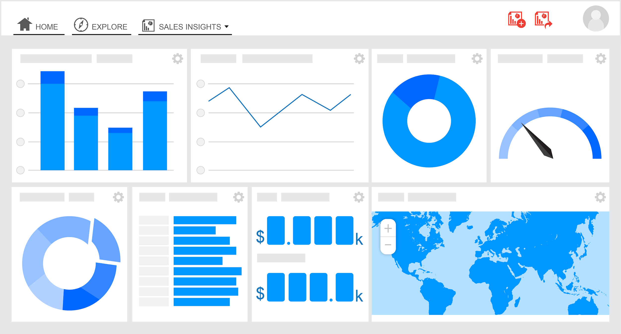
First, what is a dashboard?
A visual display of the most important information needed to achieve one or more objectives, consolidated and arranged on a single screen so the information can be monitored at a glance.

Slide 30
1. Choose metrics that matter
What are your organization’s core objectives?
How do your efforts contribute to those objectives?
Do you have data, either internal or external, that can shed light on the objectives?
Can you design a meaningful metric that measures those contributions?
Is this metric truly necessary to explain your contribution to the objectives?
Can you build a systematic and ongoing means of measurement?
Notes:
Choosing what metrics to include in the dashboard is critical. Above all, they must be metrics that matter and that are relevant to the job at hand. But that doesn’t mean every metric should be included – far from it. You should be highly selective in determining which metrics earn a spot on your dashboard. In order to find the right set of metrics to include, you need to consider the following:

Slide 31
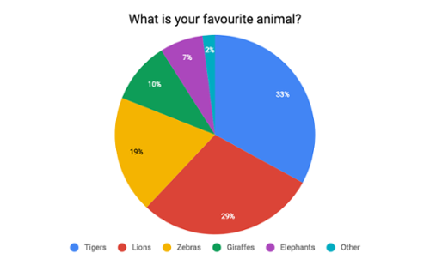
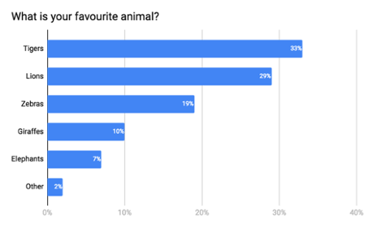
2. Keep it visual
Dashboards need to be fast and easy to read.
Text-based tables are not easy for the brain to process.
Leverage visual perception by embracing the use of colors, shapes, lines, thicknesses, and degrees of shading.
Limit the number of dimensions in the chart.
Notes:
Dashboards are meant to be fast and easy to read. Report and text-based tables are not fast or easy to read. This is a case where a picture really is worth a thousand words. Because the human brain processes a single number, a visualization or a picture as single “chunks” of information, a report or data table filled with numbers requires the brain to store and remember multiple chunks while visualizations or pictures require single chunks. So the process of comprehension and insight is dramatically faster with visualization.
An example of using geometry to your advantage is the pie chart vs. bar chart. Looking at the pie chart, it’s not obvious how the different slices stack up in terms of size. You can, of course, find out by doing the math yourself, looking at the slices’ values. However, a chart meant to visualize size differences that forces you to do math to figure out size differences is not much better than a table, although it’s prettier. A better option for visualizing the parts-to-whole relations of a data set is the bar chart. This is because it lets us compare the different objects by their length, which is one dimensional. Comparing objects along one dimension is a lot easier than along two, which makes comparing the length of bars a lot easier than the areas of pie slices.

Slide 32
3. Make it Interactive
A dashboard needs to be customizable so viewers can get the information they need.
Users should be able to perform basic analytical tasks, such as filtering the views, drilling down, and examining underlying data – all with little training.
Accommodate user needs by using automated software features or producing multiple views.
Notes:
Viewers need to be able to literally get the big picture from the dashboard that everyone sees and then be able to drill down into a view that tells them what they need to know to get their jobs done.

Slide 33
4. Keep it current
Underlying data needs to be current and metrics should reflect current challenges.
Data that is out-of-date is not necessarily worse than no data. But, out-of-date data does lend a false sense of confidence to decisions.
You need the ability to change and update the metrics represented in your dashboard.
Notes:
Make sure that the data underlying your dashboard is current and that your selected metrics reflect current business challenges. Data can be from this quarter, this week, this hour— whatever the right timeline is for your business. Data that is out-of-date is not necessarily worse than no data. But, out-of-date data does lend a false sense of confidence to decisions. You think you’re making fact-based decisions but the data is no longer representative of or relevant to your current situation. That being said, be realistic: you don’t necessarily need up-to-the-minute data. It’s more than possible that a dashboard of last month’s metrics is meaningful enough to help guide and inform this month’s activities. And, sometimes seeing metrics change by hour is just noise.

Slide 34
5. Make access and use simple
Create a prototype and ask for feedback.
Web distribution is ideal – especially if the dashboard can pull current data while adhering to IT protocols and security standards.
If you can’t publish to the web in a way that is easy to maintain and update, then consider alternatives like posting files on websites, Wiki’s or blogs.

Slide 35
Seven mistakes to avoid
Starting off with too much complexity.
Using metrics no one understands.
Cluttering the dashboard with unimportant graphics and unintelligible widgets.
Underestimating the time or resources to create and maintain the dashboard.
Failing to match metrics to the goal.
Using ineffective, poorly designed graphs and charts.
Notes:
Choosing what metrics to include in the dashboard is critical. Above all, they must be metrics that matter and that are relevant to the job at hand. But that doesn’t mean every metric should be included – far from it. You should be highly selective in determining which metrics earn a spot on your dashboard. In order to find the right set of metrics to include, you need to consider the following:

Slide 36
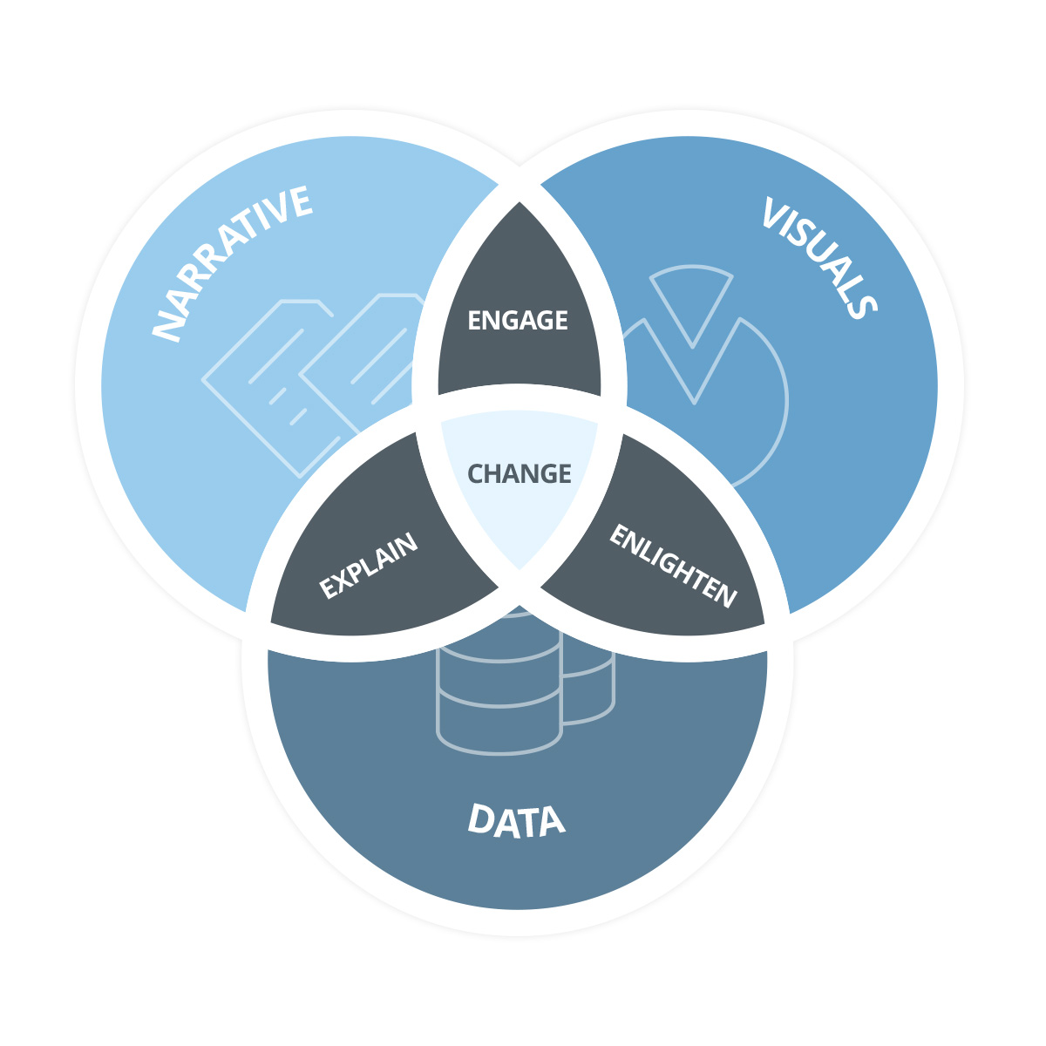
From dashboards to storytelling
Dashboards help your monitor your data. If you notice a change or problem, you can drill down and investigate the cause.
But when you need to communicate your findings —when you need to convince them to take action—you need to show them why.
By putting data in a sequence - a story - you can help viewers understand the context.

Slide 37
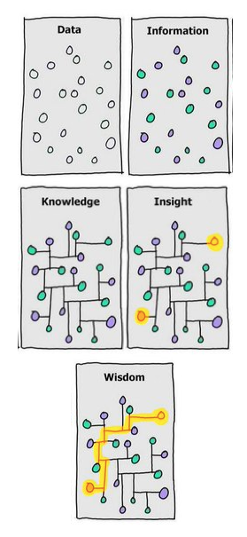
Best practices for effective storytelling
Think of the analysis as a story and use a narrative structure.
Be authentic, supplementing facts with metaphor, anecdotes or other qualitative data.
Be visual, designing your graphs for instant readability while allowing for layers of meaning.
Make it easy for the audience by sticking to 2-3 key issues.
Invite and direct discussion.
Notes:
Good story-telling will take your audience from an understanding of the raw data all the way to the wisdom of knowing how they can use it to achieve their goal.

Slide 38
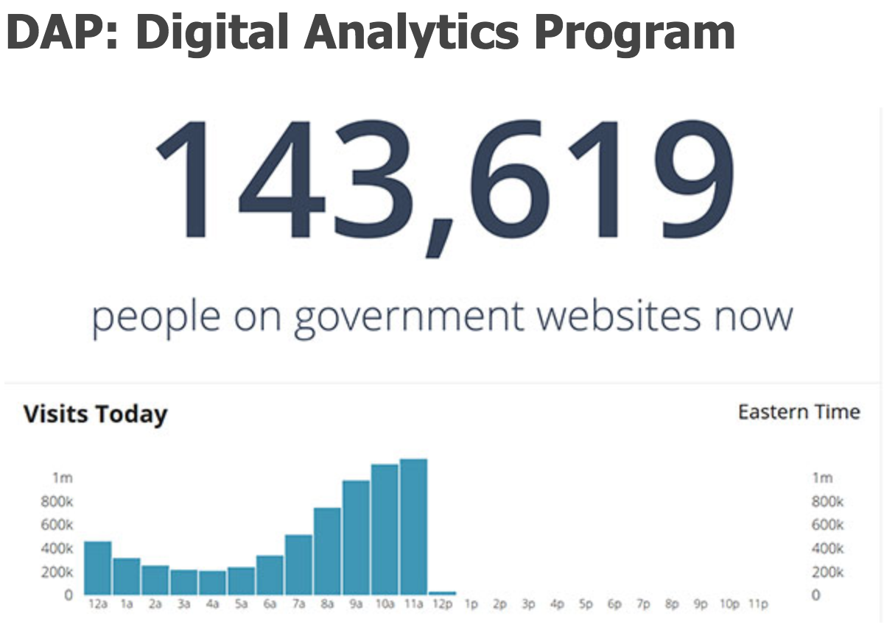
Example of a good dashboard
GSA’s Digital Analytics Program offers advanced Web analytics to federal agencies. Their data provides a window into how people interact with the government online.
Their dashboard embodies two of the most important elements of a good dashboard:
Glanceability
Simplicity
Notes:
Glanceability
Everyone should be able to see and understand a dashboard’s metrics at a glance. This means having a large enough font, recognizable visualization, and clear structure.
Simplicity
Dashboards are not an appropriate venue for artistic impression. Anything that detracts from the metrics themselves should be stripped away from the dashboard. This means using minimal color (both amount of color and number of colors), a plain background, no 3D elements, and no raw data.

Slide 39
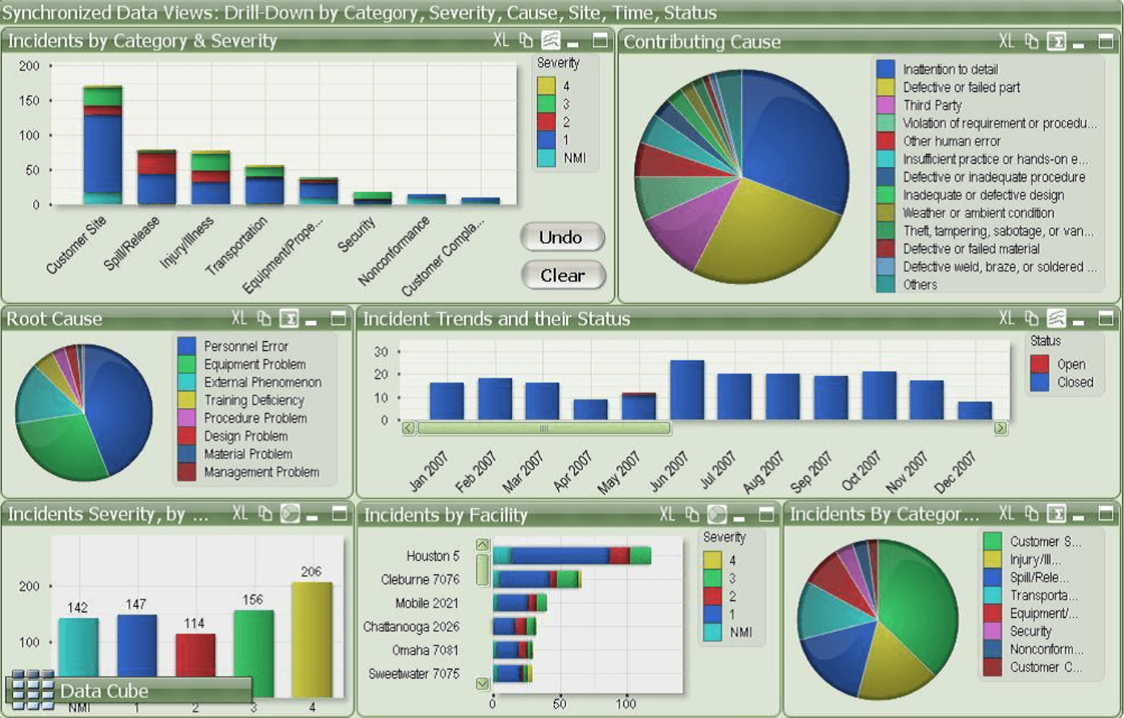
What’s wrong with this dashboard?
Notes:
What’s wrong with this dash?
Not glanceable - If you were to display this dashboard on a TV, the stacked bar charts may be difficult to understand at a glance. You would need to get up close to dissect the segments and spend time understanding everything. This dashboard relies heavily on legends (for both pie charts and bar/column charts) which adds an additional cognitive barrier.
Overuse of color - The amount of color in this dashboard is distracting and makes it complicated to understand (i.e. the colors represent different items in each widget - with the exception of the top-left widget and bottom-left widget). This creates a huge cognitive barrier for the brain when trying to process the data quickly.
Pie charts - Rarely are pie charts a good visualization for data. In this case especially, the large data set (“Contributing Cause” widget) makes the pie chart exceptionally awful since it’s impossible to determine the percentage of each item. Also, since the legend is separate from the visualization, the user has to look back and forth to read the widget. Basically, the only negative design feature not included in this pie chart is 3D.
How to fix it:
Change the visualizations to more clearly articulate the most important metric. Each visualization should help answer the question ‘What action needs to be taken?’ Make sure the visualization is large enough to be seen at a glance (this includes text widgets and labels). Adding goals and targets to the visualizations, would also make it more actionable as there is no context for KPIs currently.
Reduce the number and amount of color to only the absolutely necessary. A helpful approach is to reduce the colors to green for ‘good’, blue or yellow for ‘average / in progress’, and red for ‘bad’. But remember that good/average/bad indicators don’t replace goals and benchmarks.
Replace the pie charts with an alternative visualization. Generally, bar or column charts work well. Ideally, you’d use a single color for all series to remove the cognitive barrier of color for viewers too.

Slide 40
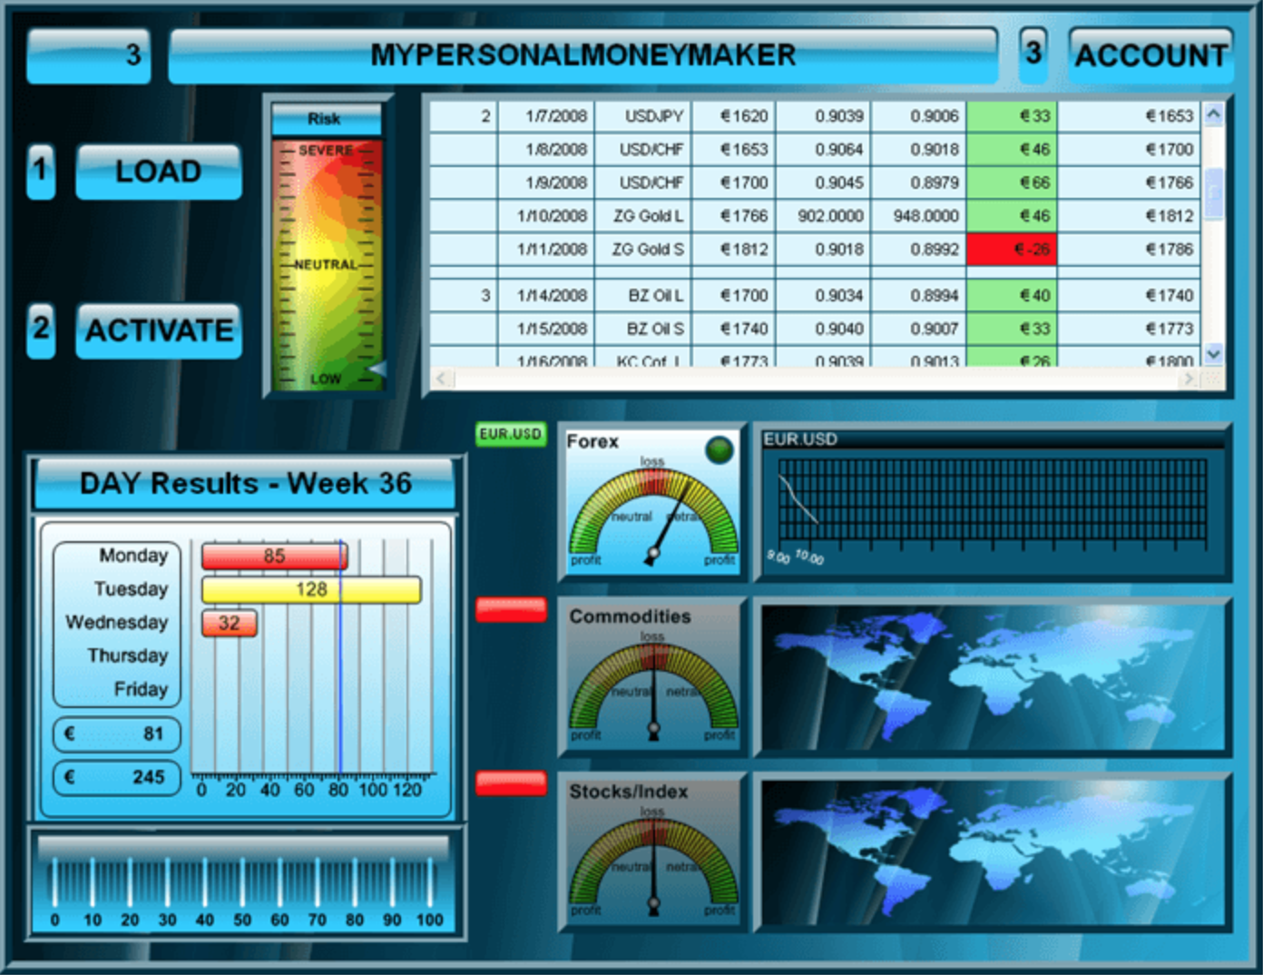
What’s wrong with this dashboard?
Notes:
What’s wrong?
3D visualizations - This added texture throughout the dashboard detracts from the key metrics and make the overall appearance very busy and difficult to process in a glance. Ultimately, 3D visualizations can distort the reality of numbers and lead to slow processing of data or misinterpretation.
Distracting borders and background - The unnecessary color and patterns used in the background and borders obscure the actual data. Edward Tufte said it best regarding data to ink ratios, “Above all else show the data.”
Lack of filtered data - This dashboard has too much raw data and too much detail, particularly the embedded spreadsheet section. You would have to spend time staring at the raw data to understand what’s going on.
Insufficient labels and context - What’s the visualization on the bottom left? What do the red tabs mean next to the gauges? What are the 3s at the top? What do the maps show? Also, the detail is poor. The gauges don’t show numbers. They’re all dumbed down to not actually show you the number which would be simpler and more precise.
How to fix it:
Simplify the background by removing all 3D effects and excessive color variations. Why are there lines in the background? It just distracts from what really matters: the data.
Remove raw data and replace with only filtered, key metrics. An effective TV dashboard should never display an embedded spreadsheet. Pick the most important metrics from the spreadsheet and display them using a graph, bar, or column visualization. Perhaps even a single number widget with a goal or sparkline would be sufficient. Eliminate any unnecessary icons (e.g. 3s at the top).
Make visualizations clear and precise. Use numbers for the gauge including a goal. The background of the line graph widget ‘EUR USD’ can be simplified to draw attention to the line itself (once again focusing on the metrics, not the visualization itself).
Properly label widgets to provide the necessary context for each metric, ensuring the viewer quickly knows what they’re looking at.

Slide 41
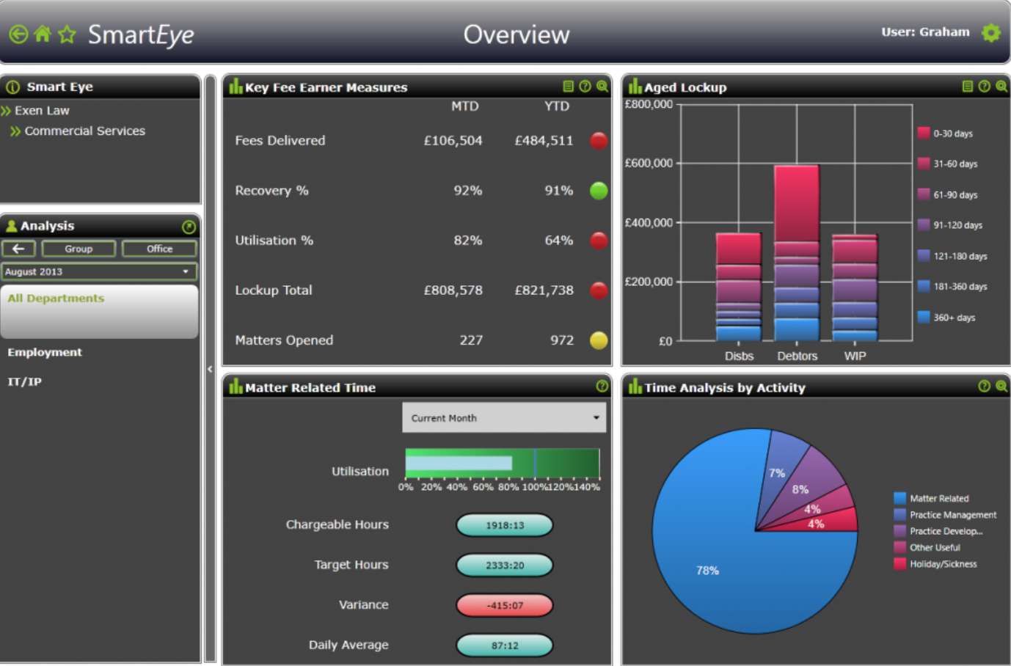
What’s wrong with this dashboard?
Notes:
What’s wrong?
Confusing colors - The plain background is quite helpful as it makes the visualizations stand out, however the subtle variation in shade (e.g. right two widgets) actually makes it more difficult to segment the legend. The middle two widgets display at least five new colors - lacking consistency and simplicity.
Pie charts - Once again, pie charts are a poor choice for data visualization. In this instance, the percentage is shown directly on the pie chart - which helps, but the user still has to look back and forth across the visualization to read the legend.
Font too small - The labels would be quite difficult to read from a distance.
How to fix it:
Use color intentionally. Avoid subtle variations in shade since they’re more difficult to distinguish from a distance (e.g. widgets on the right). Eliminate unnecessary color (e.g. blue lozenges in the bottom middle widget). While using red, yellow, and green in the ‘Key Fee Earner Measures’ section is a good start, using up/down icons or goals/benchmarks would be even better (especially for color blind individuals).
Replace the pie charts with an alternative visualization (bar or column charts work well).
Increase font size so the labels are clearly visible when displayed on a TV dashboard.

Slide 42
Data Driven Reviews (AKA Stats)
Dana Roberts

Slide 43
Where did DDRs come from?
Federal Agency, Bureau, Program, Goal DDRs
EXAMPLES
HUDStat (2010) FEMAStat (2011) CDC’s Winnable Battles (2010) APG & CAP QPRs (2010)
StateStat (MD) (2007) GMAP (WA) (2005)
CityStat (Baltimore) (2000) New Orleans BlightStat PhillyStat (2008)
NYC (1994) over 500 police departments across the US by 2000
State Management Stats
“State Stat”
Vestibulum congue
Other City Services City management
“City stat”
Vestibulum congue
City Policing
“CompStat”
Notes:
CompStat, New York City Police Department (1994)
–Began holding biweekly “Operational Performance Reviews” to focus interventions, review relevant data, address issues and devise solutions
–Greater enforcement of misdemeanor offenses greatly reduced NYC crime rate, including violent crime rate
Model spread to over 500 police departments by the year 2000
Further expansion throughout the next decade: city, state, federal
–Baltimore (CitiStat), New Orleans (BlightStat)
–Washing State, Ohio, Maryland
–U.S. Border Patrol’s “BorderStat”
Federal examples
–FDA-TRACK, HUDStat, FEMA Stat, Treasury Stat

Slide 44








What is a Data Driven Review (DDR)?
Leadership engagement
Data analyzed to inform decisions
Defined purpose
Follow-up
Effective DDRs
Openness and candor
Feedback with eye towards learning
Relevant and recent data
Regularity and routine

Slide 45
No two DDRs look the same – with good reason
DDRs can target a single goal OR program area
DDRs can take a lot OR few resources
DDRs can span an entire organization OR a team
DDRs can be structured differently
DDR ‘culture’ is set by leadership
DDRs can look at all levels of measurement - outcomes, outputs or process metrics and milestones
DDRs can evolve over time to meet leadership’s evolving needs

Slide 46



Best practices - participating in a DDR
Embrace the opportunity – Leadership has different perspectives and strategizing with them on challenge areas can open up new doors
Come prepared – Make sure you have the data that is requested and you understand it. If possible, bring an analyst with you to answer complex question.
Don’t be afraid to follow-up – if you don’t know the answer, promise to deliver it at a later date
Stop Assuming – Correlation does not equal causation
Ask for help – your leadership wants you to succeed – if you need help, ask for it (although no $)
Follow through - Deliver on actions requested or promises made at these meeting

Slide 47
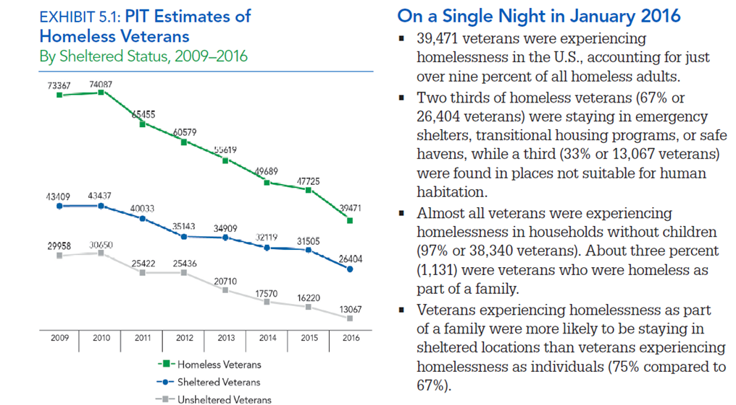
Case in point:
HUD Veteran’s homelessness
HUDstat begins

Slide 48
Additional resources
PIC.gov – Resources Page
Performance CoP Listserv – email PICStaff@gsa.gov
FedEval listserv – email CaracelliV@gao.gov
Better Government movement https://innovation.gov/

Slide 49

Reflection and Discussion
What key insights would you like to share with the group?
49

Slide 50
Questions?
Boris Arratia Boris.Arratia@gsa.gov
Steve Richardson Richardson.Steven@dol.gov
Todd Coleman Todd.Coleman@gsa.gov
Dana Roberts Dana.Roberts@gsa.gov
Need more help? Fed2FedSolutions@GSA.gov

Slide 51
Back-Up Slides

Slide 52
Data Sources & Collection Tools
Federal data sources
A federal data collection solution
Commercial data collection solutions
Data collection best practices

Slide 53
Bureau of Economic Analysis - data on economic indicators, national and international trade, and industry.
Bureau of Justice Statistics - data on justice systems, crime, criminal offenders, and victims of crime.
Bureau of Labor Statistics - data on U.S. labor market activity, working conditions, and price changes.
Bureau of Transportation Statistics - data on airline on-time performance, pirates at sea, transportation safety and availability, motorcycle trends, and more.
Census Bureau - the main source of data about our nation's people and economy.
Digital Analytics Program - data on how people are interacting with the government online.
Energy Information Administration - provides data on U.S. use of coal, natural gas, nuclear energy, renewable energy, and more.
National Agricultural Statistical Service - data on food production and supply, organic sales, chemical use, demographics of U.S. producers, and more. Every five years it conducts the Census of Agriculture that provides agricultural data for every county in the United States.
Data.gov - the home of the U.S. Government's open data.
Office of Personnel Management - Federal civilian workforce data with FedScope.
Internal Revenue Service Statistics of Income - examines tax returns to report on such things as sources of income, exemptions, use of medical savings accounts, migration and geographic data, tax information on foreign corporations controlled by U.S. parent corporations, exports, international boycotts, and investments and activities in the U.S. by foreign persons.
Federal Data Sources
National Center for Education Statistics - data on education in the US, specifically the Digest of Education Statistics and the Condition of Education, which are reports on the progress of American education.
National Center for Health Statistics - the principal health statistics agency
National Center for Science and Engineering Statistics publishes data on the American science and engineering workforce and the progress of STEM education in the US.
Social Security Administration Office of Research Evaluation and Statistics - data on social security program benefits, payments, covered workers, and more.

Slide 54
2. A Federal Data Collection Solution
MAX Collect
MAX Collect is a web-based application used to create structured data collections. Through MAX Collect, respondents enter data onto a web page which is saved to a secure database.
Benefits of MAX Collect
Save time collecting data: Compile data into one document with the push of a button instead of manually copying and pasting each submission into a master file.
Save time publishing: Style and format your documents once using a style sheet instead of manually formatting each publication. The MAX Collect team member assigned to your project will help you submit style sheet requests.
Useful data: Published PDF's are fully searchable and include a table of contents that links to the correct page of the document.
Uniform data: Restrict the format in which users submit data.
Web accessible: MAX Collect can be accessed from any internet browser.
Analyzable data: Max Collect data can be queried using MAX Analytics to produce summary reports, charts, graphs, and more

Slide 55
3. Commercial Data Collection Solutions
Qualtrics
Qualtrics lets users collect and analyze data online for different purposes, including market research, customer satisfaction and loyalty, product/concept testing, employee evaluations, and website feedback.
Survey Monkey
SurveyMonkey provides free, customizable surveys as well as a suite of paid back-end programs that include data analysis, sample selection, bias elimination, and data representation tools. They also offer enterprise options.
Alternatives to Survey Monkey
SurveyGizmo
QuestionPro
Getfeedback
Key Survey
QuickTapSurvey
NOTE:
The Federal Information Security Management Act requires that federal government agencies assess and monitor the security risks of products before granting them an Authorization to Operate (ATO).

Slide 56
4. Data Collection Best Practices
Be transparent
Tell people how and why you’re collecting their data, allow them to opt in or out. This builds trust.
Speak in plain language
Technical language and small print make people feel uncomfortable and intimidated. Plain language, however, makes your data policies easy to understand, which makes collection easier.
Make the data exchange mutually beneficial
Share the results of the data collection to create real value for those providing the data.
Safeguard your data
Back up your data; mask PII; Store in a safeguarded system; and have a plan in the event of a breach.
Know the regulations
Know the rules and regulations surrounding data collection, particularly FISMA.
Know your boundaries
Be cognizant of how frequently you make data calls to avoid survey fatigue.
Set data governance policies and guidelines
Data governance refers to policies and guidelines that define acceptable uses of data, authorized access to data, and management of the data.
Ensure data quality
Your data sets need to be checked and cross referenced for data quality.

Slide 57
Data Storage: The Case for Server-based Databases
4/6/2018
Office of Government-wide Policy | Office of Evidence and Analysis
57

Slide 58
Data Storage Overview
What is a database?
Benefits of a database
How to choose your data storage method
Advantages of server vs local storage

Slide 59
What is a database?
Databases are computer systems that manage the storage and querying of datasets.
They organize data on disk (i.e. hard drive) and provide efficient methods to retrieve information and ensure proper data management and verification.
Typically, retrieval is performed using a query language, a mini programming language with a few basic operators for data transformation. The most common query language is SQL (Structured Query Language).
The most common type of database is the relational database, which is based on links between data entities or concepts. There are also non-relational databases (often referred to as noSQL databases).

Slide 60
2. Benefits of a database
You can query data in a database (ask it questions).
You can look up data from a database relatively rapidly.
You can relate data from two different tables.
You can create meaningful reports from data in a database.
Your data has a built-in structure to it.
Information of a given type is always stored only once.
Databases are ACID (Atomicity, Consistency, Isolation, Durability), which guarantees validity even in the event of errors, power failures, etc.
Databases are fault-tolerant.
Databases can handle very large data sets.
Databases are concurrent; multiple users can use them at the same time without corrupting the data.
Databases scale well.
Notes:
Tell the story about the early days of benchmarking vs. when we had the data in a database.

Slide 61
3. How to choose your data storage method
When to use a relational database (e.g. SQL):
You have relational data
You have large amounts of data and you need to be able to locate relevant information quickly
You need to start worrying about the previous issues identified: scalability, reliability, ACID compliance
You need to use reporting or intelligence tools to work out business problems
When to use a non-relational database (NoSQL)
You have lots of data that needs to be stored which is unstructured
You have scalability and speed needs
You generally don't need to define your schema upfront, which allows for changing requirements
When to use files
You have unstructured data in reasonable amounts that the file system can handle
You don't care about structure, relationships
You don't care about scalability or reliability (although these can be done, depending on the file system)
You don't want or can't deal with the overhead a database will add
You are dealing with structured binary data that belongs in a file system, for example: images, PDFs, documents, etc.

Slide 62
4. Advantages of server vs local storage
Efficiency: By storing your data in a server, you save disk space. Storing locally consumes disk space. Working with large datasets might be impossible if local memory limits are low.
Accessibility: If you’re server allows it, you can connect to your data anywhere in the world. If you’re data is local, you have to manually share it and then manage version control.
Safety: Local hard drives are often more vulnerable to data loss through accidental file deletion, viruses, mechanical damages, power failure, and theft. Servers are less vulnerable.
Security: Security measures are applied across a server no matter who is accessing the data. Multiple instances of local storage present multiple targets, each with varying levels of security.
Collaboration: Servers are designed to be accessed from multiple points and administrators can set role-based permissions. With local files, you cannot control who has access once you email the file.
Recovery: Server storage has more advanced means for data recovery.

Slide 63
























Analytics with and without a database
Notes:
Top swimlane: the database
Multiple people can submit their data
The database takes care of security, maintenance, data transformations, documentation and task scheduling.
The output of the data is always assured, and this imparts consistency and validity to the visualizations and report
Bottom swimlane
Multiple people can still submit their data…
But no database means that files get misplaced, copied, shared, re-copied, replaced and even lost
Because of this, you can’t be sure of the output, and this can undermine the consistency and validity of your reports/visualizations.

Slide 64
Best practices - building a DDR
One size does not fit all; think Goldilocks
Performance routines + effective DDR meetings can transform “passive” data into “actionable” data
“Deep dives” outside of DDR meetings can greatly improve discussion and improve decision-making in DDR meetings
Don’t check ethics and values at the door of your DDR meetings
Ask for help and look to other examples for insight
Contact Fed2FedSolutions@GSA.gov for a list of best practices and other resources

